Slide 1

Knowledge Graph
NAME : Saniya TOPIC : IPCC WG2 – Chapter 10: Asia

Slide 2

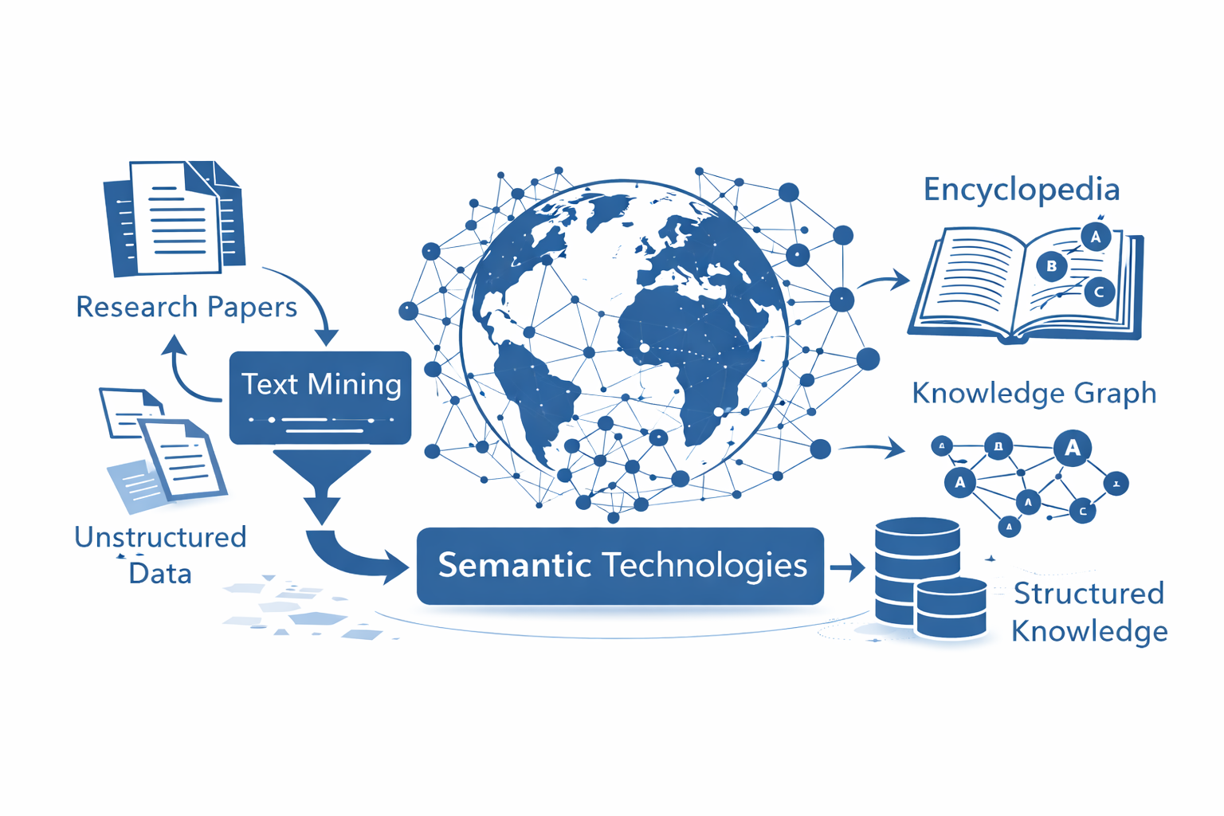
Semantic Climate is an open-source initiative focused on extracting, structuring, and linking climate knowledge from scientific literature.
It uses:
Automated text mining
Semantic technologies
To transform:
Unstructured research papers Into:
Organized, machine-readable knowledge resources
Encyclopedias
Knowledge Graphs
This enables easier discovery and reuse of climate information.

Slide 3
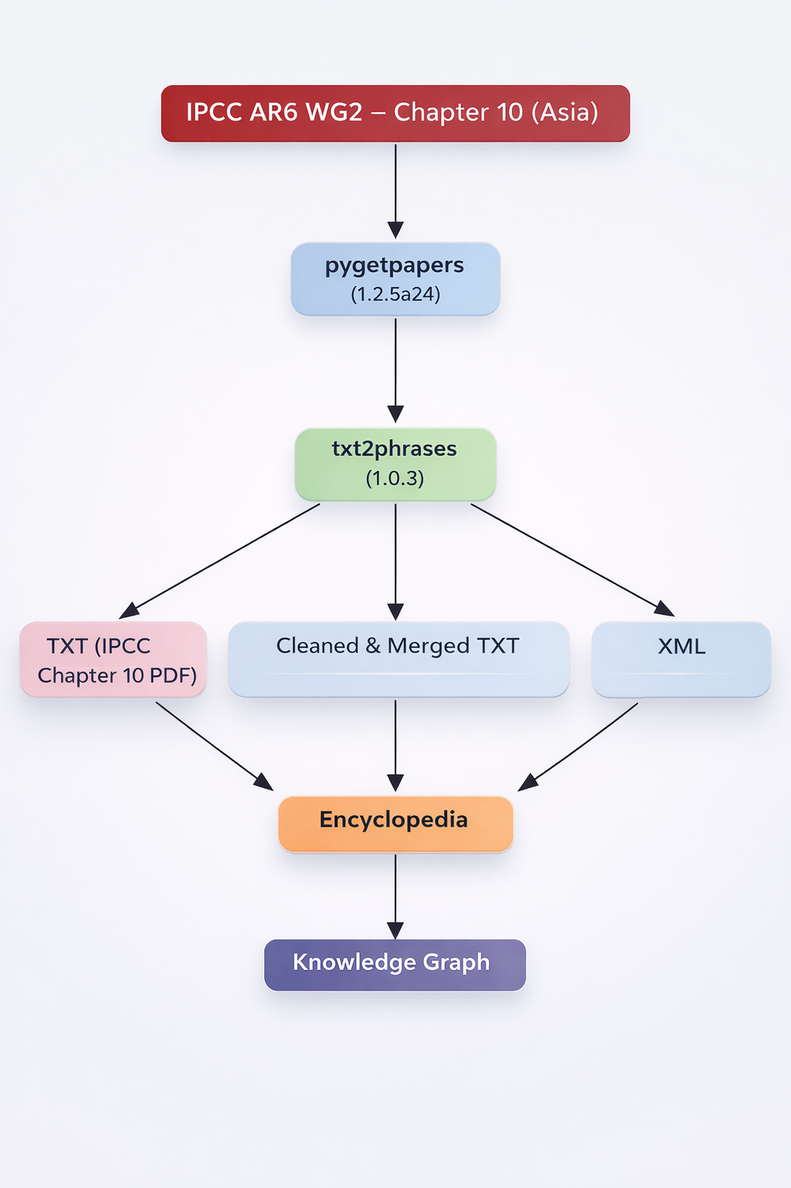
work flow

Slide 4
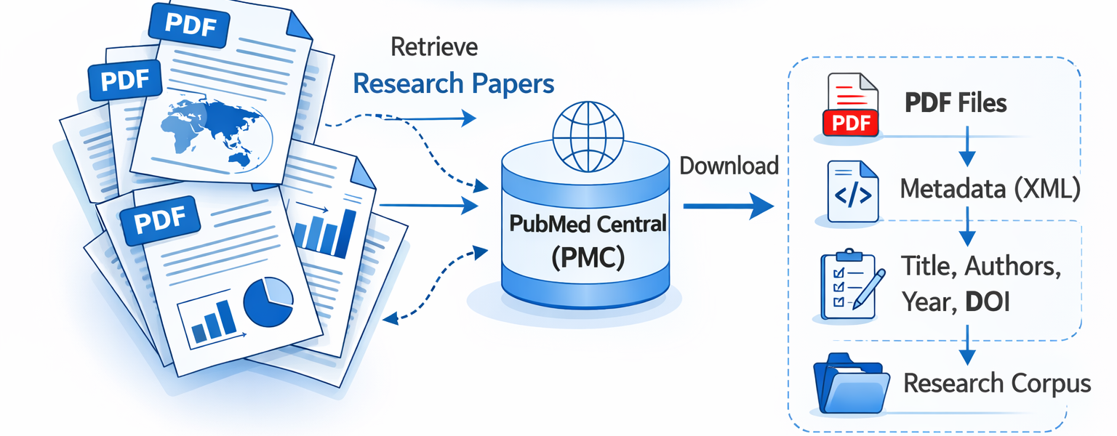
Pygetpapers
Pygetpapers is an open-source literature retrieval tool.
It:
Searches scientific articles
Downloads full-text papers
Collects metadata
Retrieves PMC IDs
Used for:
Large-scale research collection
Reproducible text-mining workflows

Slide 5
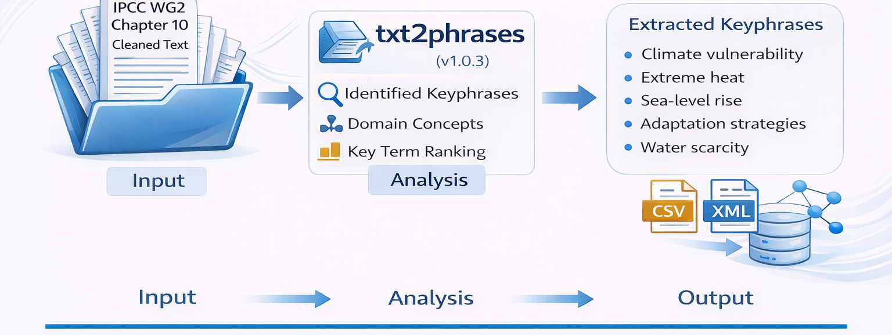
Txt2phrases
txt2phrases is a text-mining tool that extracts important keyphrases from large text documents. In this project, it was used to analyze the cleaned text of IPCC AR6 WG2 Chapter 10 (Asia) and identify major climate-related concepts such as climate vulnerability, sea-level rise, extreme heat, and adaptation strategies. The extracted phrases were then converted into structured formats (CSV and XML) for building the encyclopedia and knowledge graph.

Slide 6
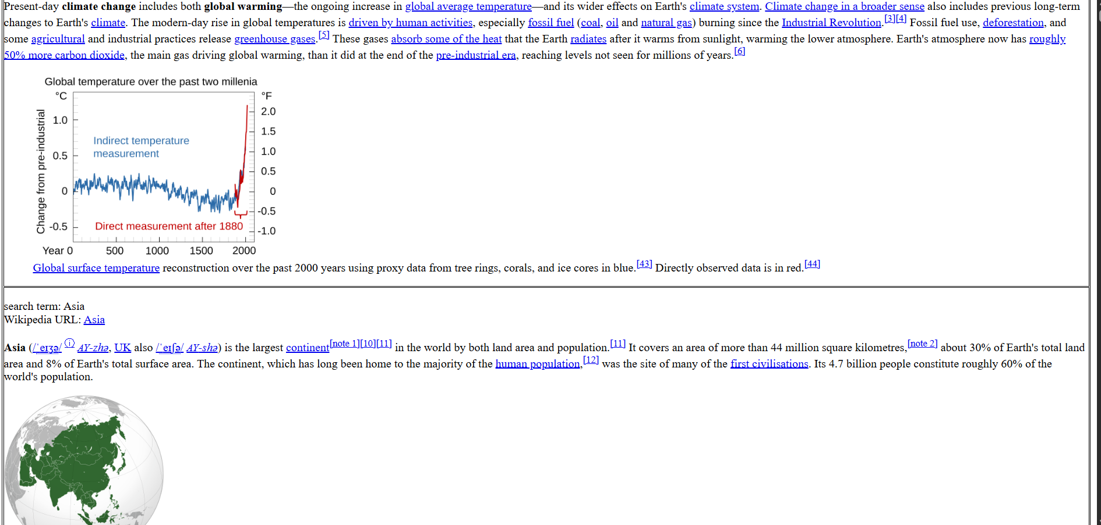
Encyclopedia

Slide 7
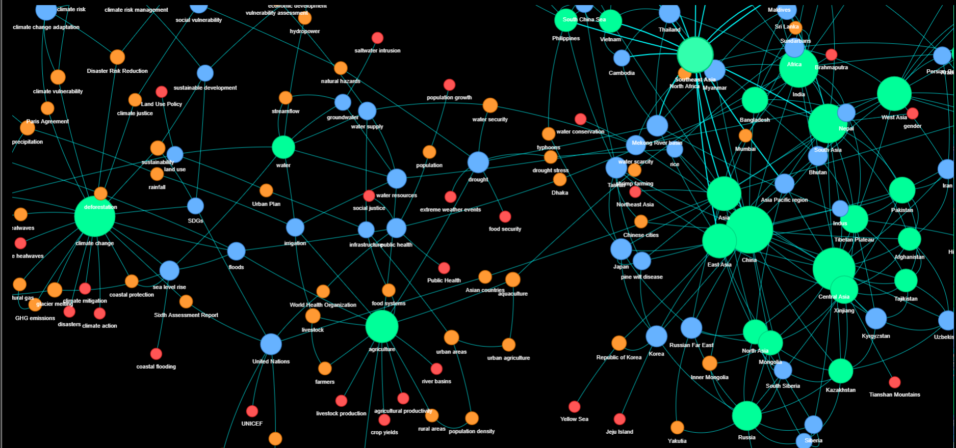
Knowledge Graph

